Slide 3





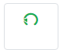
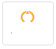
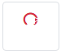
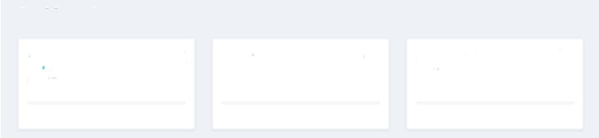
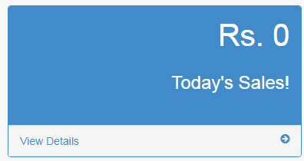
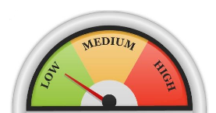
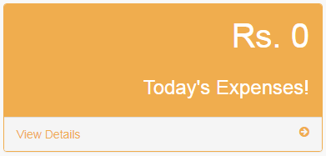
Type : Factory Outlet
State : TN
District : Chengalpattu
Store : 1796
DASHBOARD
Master +
Finance +
Accounts +
Inventory +
Butterfly Auditor +
My Reports +
My Cart
Sales Invoice
Place Orders
Token Master
My Orders
SOC Check
Stock Check
RISKOMETER

Slide 4
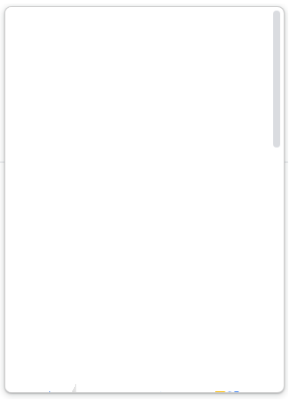

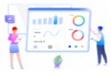






Type : Factory Outlet
State : TN
District : Chengalpattu
Store : 1796
DASHBOARD
Master +
Finance +
Accounts +
Inventory +
Butterfly Auditor +
My Reports +
My Cart
Sales Invoice
Schemes
B. Analytics
Marketing
Place Orders
My Complaints
Fixed Asset
SOP
Token Master
HRM
CRM
My Orders
SOC Check
Stock Check
RISKOMETER

Slide 5
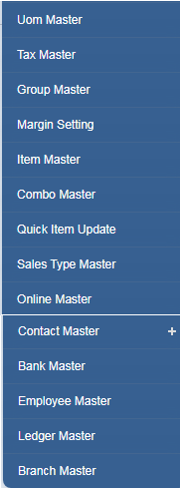
Type : Factory Outlet
State : TN
District : Chengalpattu
Store : 1796
DASHBOARD
Master +
Finance +
Accounts +
Inventory +
Butterfly Auditor +
HRM +
CRM +
My Cart
Sales Invoice
Place Orders
Token Master
My Orders
My Reports
Stock Check
RISKOMETER

Slide 6
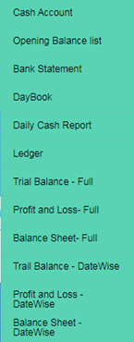
Type : Factory Outlet
State : TN
District : Chengalpattu
Store : 1796
DASHBOARD
Master +
Finance +
Accounts +
Inventory +
Butterfly Auditor +
My Cart
Sales Invoice
Place Orders
Token Master
My Orders
My Reports
Stock Check
RISKOMETER

Slide 7
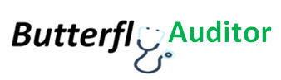
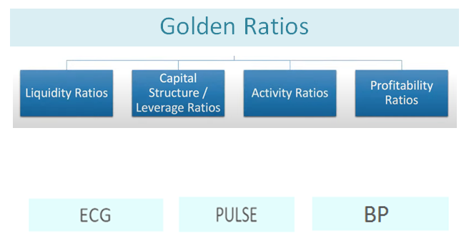
Type : Factory Outlet
State : TN
District : Chengalpattu
Store : 1796
DASHBOARD
Master +
Finance +
Accounts +
Inventory +
Butterfly Auditor +
My Cart
Sales Invoice
Place Orders
Token Master
My Orders
My Reports
Stock Check
RISKOMETER

Slide 8
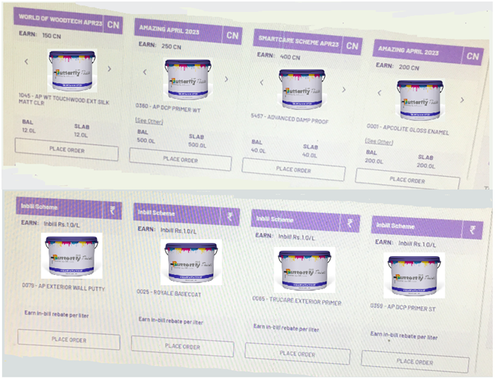
Type : Factory Outlet
State : TN
District : Chengalpattu
Store : 1796
DASHBOARD
Master +
Finance +
Accounts +
Inventory +
Butterfly Auditor +
HRM +
CRM +
My Cart
Sales Invoice
Place Orders
Token Master
My Orders
My Reports
Stock Check

Slide 9
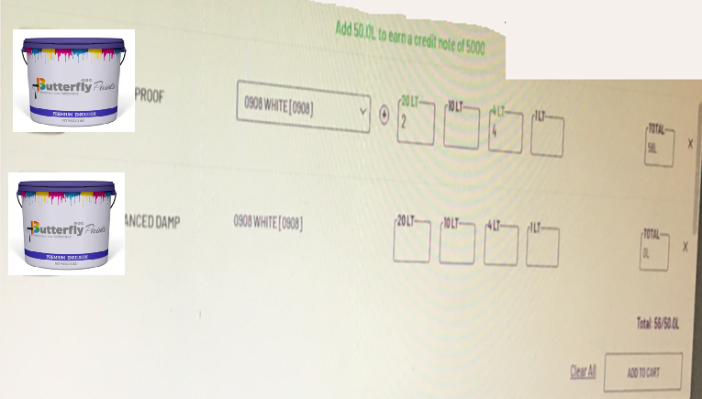
Type : Factory Outlet
State : TN
District : Chengalpattu
Store : 1796
DASHBOARD
Master +
Finance +
Accounts +
Inventory +
Butterfly Auditor +
My Cart
Sales Invoice
Place Orders
Token Master
My Orders
My Reports
Stock Check

Slide 10
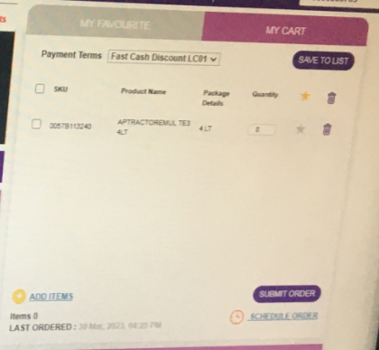
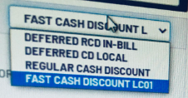
Type : Factory Outlet
State : TN
District : Chengalpattu
Store : 1796
DASHBOARD
Master +
Finance +
Accounts +
Inventory +
Butterfly Auditor +
My Cart
Sales Invoice
Place Orders
Token Master
My Orders
My Reports
Stock Check

Slide 11

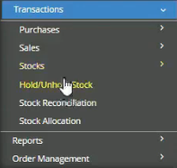
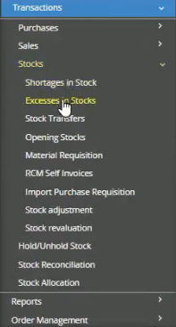
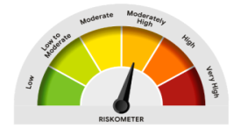
DASHBOARD
Master +
Finance +
Accounts +
Inventory +
Butterfly Auditor +
HRM +
CRM +
Reports +
Sales Invoice
My Orders
Token Master
Schemes
My Complaints
Business Intelligence

Slide 12
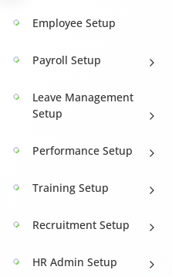
DASHBOARD
Master +
Finance +
Accounts +
Inventory +
Butterfly Auditor +
HRM +
CRM +
Reports +
Sales Invoice
My Orders
Token Master
Schemes
My Complaints
Business Intelligence

Slide 13
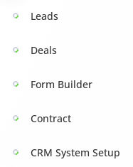
DASHBOARD
Master +
Finance +
Accounts +
Inventory +
Butterfly Auditor +
HRM +
CRM +
Reports +
Sales Invoice
My Orders
Token Master
Schemes
My Complaints
Business Intelligence

Slide 14
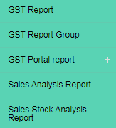
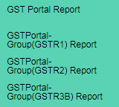
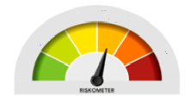
DASHBOARD
Master +
Finance +
Accounts +
Inventory +
Butterfly Auditor +
HRM +
CRM +
Reports +
Sales Invoice
My Orders
Token Master
Schemes
My Complaints
Business Intelligence

Slide 15
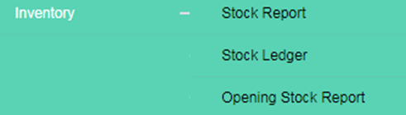
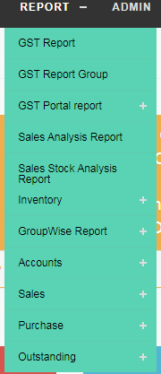
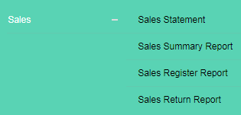
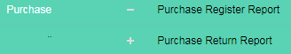
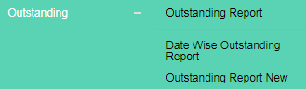
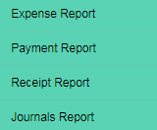
REPORT

Slide 16


Slide 17
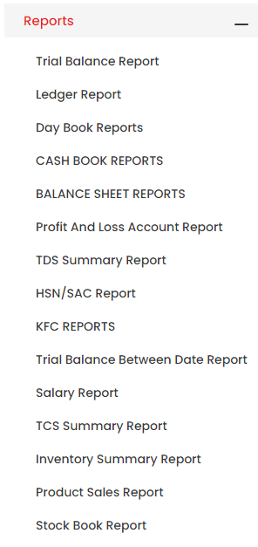
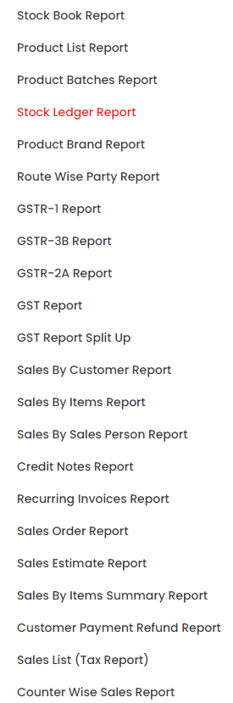
https://www.accoxi.com/help/reports/stock-ledger-report/

Slide 18
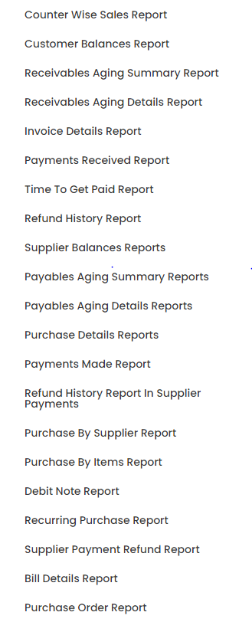
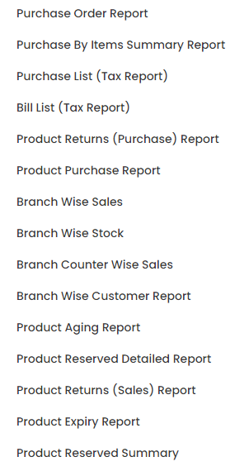
.accoxi

Slide 19
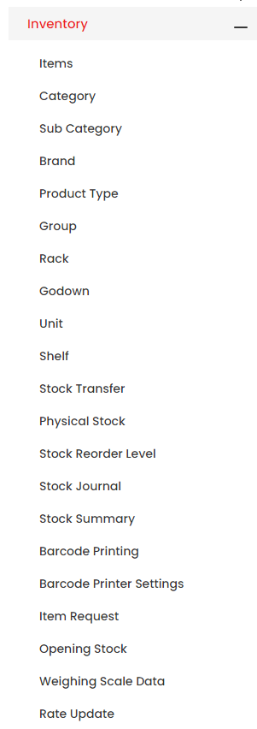
Inventory

Slide 20
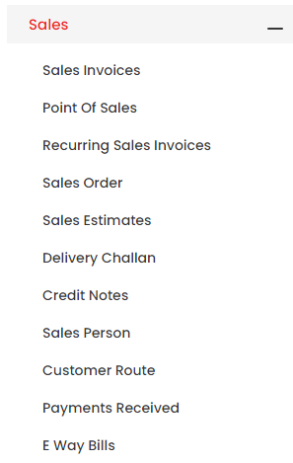
Sales

Slide 21
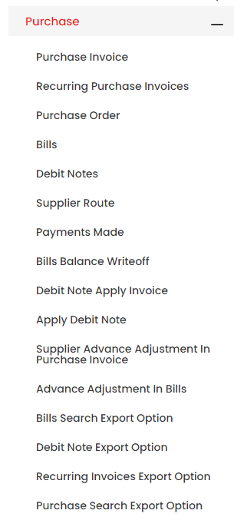
Purchase

Slide 22
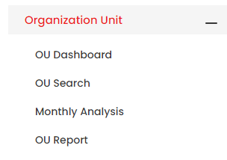

Slide 23
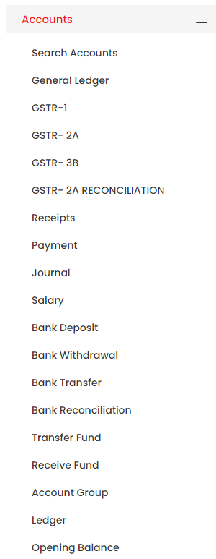
Accounts

Slide 24
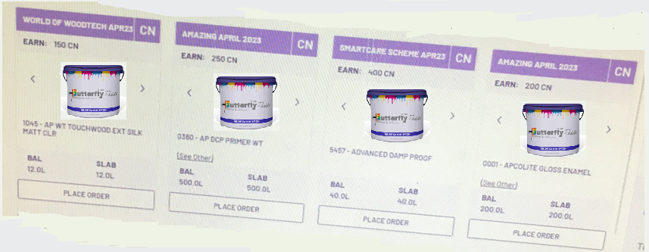
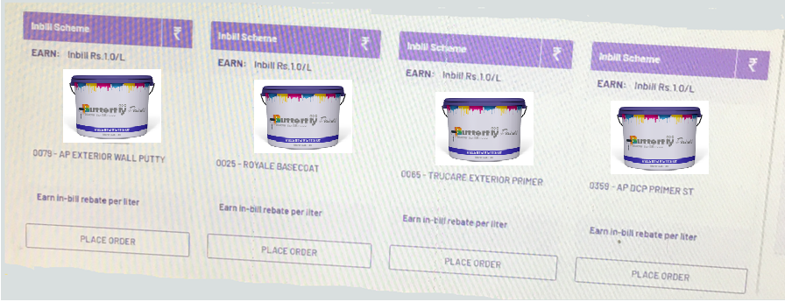

Slide 25
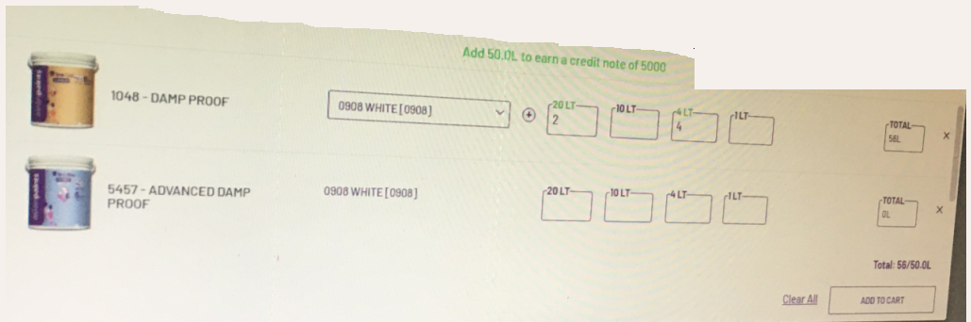

Slide 26
FACTORY

Slide 27

DASHBOARD
Master +
Finance +
Accounts +
Production +
Butterfly Auditor +
HRM +
CRM +
SCM +
Marketing +
Sales
Purchase
Schemes
Fixed assets
Business Intelligence
Complaints
RISKOMETER

